Slide 1
TODO LIST VOICE ASSISTANT USING MACHINE LEARNING
Submitted in the partial fulfillment for the award of the degree of
BACHELOR OF ENGINEERING
IN
INTERNET OF THINGS
Submitted by:
JYOTI RAWAT
19BCS4629
Under the Supervision of:
MR. NIKHIL
Department of AIT-CSE
DISCOVER . LEARN . EMPOWER

Slide 2
Outline
Introduction to Project
Problem Formulation
Objectives of the work
Methodology used
Results and Outputs
Conclusion
Future Scope
References

Slide 3
Introduction to Project
Speech is the most convenient medium of communication among the human beings.
Today the development of artificial intelligence (AI) systems that are able to organize a natural human-machine interaction (through voice, communication, gestures, facial expressions, etc.) are gaining in popularity. One of the most studied and popular has been the direction of interactions based on machines' understanding of human using natural language. It is no longer a man learning how to communicate with a machine, but a machine learning how to communicate with a man, exploring his behaviour, habits, behaviours and striving to become a personalized assistant. The creation and improvement of these personalized assistants has been around for a long time. These systems are constantly being improved and improved, and beyond personal computers, they are already firmly entrenched in a variety of mobile devices and devices.
One of the most popular voice assistants are Siri, from Apple, Amazon Echo, which responds to the name of Alexa from Amazon, Cortana from Microsoft, Google Assistant from Google, and the recently appeared intelligent assistant under the name "AIVA".

Slide 4
This voice assistant can do the following things:
Voice assistant is able to do conversation with you.
It is able to do any kind of calculation such as add, subtract, multiply, divide, trigonometric operations, etc.
This voice assistant having two voices. i.e., male voice and female voice. We can use any one
of them and we can change that voice any time.
It is able to give answer of any question.
It can open any website, YouTube, Google. We have to tell the name of that website to the voice assistant to open that website.
6. Can close the website.
7. It is able to open any app and file in your device. e.g. Word, Excel, WhatsApp, Gallery, etc.
8. It is able to tell us current time and current, tomorrow, yesterday and some other dates.
It can recognize the voice of male and female and addresses respectively as sir and mam.
10. It is able to repeat after the user commands.

Slide 5
11. It can click your photo.
12. It can take screenshot.
We can set alarm in it.
We can play Tic Tac Toe game which I have made using Tkinter and also some online games which I linked to it.
15. It is able to do sentiment analysis by inputting emojis.
16. It is able to detect human faces.
17. It can perform brightness control, sound control, night light control, etc. by voice commands.
18. It is able to play some keys of piano.
It can search files present in the system/laptop.
We can give the review to this voice assistant and it will be recorded in the database.
Other than these functions, the voice assistant can maintain your personalized to-do list in which you can add or remove any task and Further it can also recommend articles based on your to-do tasks.

Slide 6
Problem Formulation
As we know each human have their own characteristics and every developer applies his own method and approaches for development of a product. One assistant can synthesize speech more qualitatively, another can more accurately and without additional explanations and corrections perform tasks, others are able to perform a narrower range of tasks, but most accurately and as the user wants. Therefore, there is no such assistant that can perform all the work and tasks equally.
The set of characteristics that an assistant has depends on the area on which developer paid more attention. Since all system are based on machine learning and use for their creation huge amounts of data collected from various sources and then trained on them, an important role is played by the source of this data.
Despite the different approaches to learn different algorithms, the principle of building voice assistant remains the same. The technologies that are used to build a voice assistant that can interact with the humans are speech recognition, Teach-To-Speech, voice biometrics, dialog manager, natural language understanding and named entity recognition.

Slide 7
Objectives of the Work
Voice Recognition:
Voice gender identification relies on three important steps:
-> Extracting from the training set MFCC features (13 per time window usually)
-> Train two Gaussian Mixture Models (GMMs) on the feature matrices created (N_records x 13), one for each genre
-> In prediction, compute the likelihood of each gender using the trained GMMs, and pick the most likely gender
To-do list and recommendation system
C. Tasks performed by assistant:
Speech Recognition
Text-To-Speech
Python backend
System Calls
Соntent Extrасtiоn
File searching

Slide 8
Methodology used
In sound processing, the mel-frequency cepstrum (MFC) is a representation of the short-term power spectrum of a sound, based on a linear cosine transform of a log power spectrum on a nonlinear mel scale of frequency. Mel-frequency cepstral coefficients (MFCCs) are coefficients that collectively make up an MFC.
Voice gender identification relies on three important steps:
Extracting from the training set MFCC features (13 per time window usually)
Train two Gaussian Mixture Models (GMMs) on the feature matrices created (N_records x 13), one for each genre
In prediction, compute the likelihood of each gender using the trained GMMs, and pick the most likely gender
Limitations
The accuracy in test remains to improve (65%). When a user plays with his or her voice and tries to immitate the other gender, the GMM gets fooled and predicts the wrong gender. This is also due to the training data that it has seen so far which were extracted from AudioSet and Youtube.

Slide 9
Speech Recognition is a supervised learning task. In the speech recognition problem input will be the audio signal and we have to predict the text from the audio signal. We can’t take the raw audio signal as input to our model because there will be a lot of noise in the audio signal. It is observed that extracting features from the audio signal and using it as input to the base model will produce much better performance than directly considering raw audio signal as input. MFCC is the widely used technique for extracting the features from the audio signal.
Recommendation System
A recommendation system in machine learning can predict the requirements of a bunch of things for a user and recommend the top things that may be needed.
Recommendation systems are one of the most widespread applications of machine learning technologies applied for businesses.
We can find large scale recommendation systems in retail, video on demand, or music streaming.

Slide 10
There are two methods to construct a recommendation system.
1. Content-based recommendation
Uses attributes of items/users
Recommend items similar to the ones liked by the user in the past
2. Collaborative filtering
Recommend items liked by similar users
Enable exploration of diverse content
In this I have used Content based filtering using cosine similarity.

Slide 11
File search in system
First method is using sys.path.append() in Python
Sys.path is a list of directories where the Python interpreter searches for modules. And this is a list! When a module is claimed in a project file, it will search through each one of the directories in the list. If the module is located within one of those directories, then everything goes fine and your project is successfully rendered.
However, if the module is not located within any of the listed directories, then your project will fail lest you can “append” the directory where your module is located to the list using the append() function.
Second method is using os.walk() function.
Python can search for file names in a specified path of the OS. This can be done using the module os with the walk() functions. This will take a specific path as input and generate a 3-tuple involving dirpath, dirnames, and filenames.
If we are searching for a file named smpl.html starting at the root directory named “D:\”. The os.walk() function searches the entire directory and each of its subdirectories to locate this file. As the result we see that the file is present in both the main directory and also in a subdirectory.

Slide 12
Results and Outputs
I have discussed the design and implementation of a To-do list voice assistant using machine learning. The project is built using open source software modules with VS Code backing which can accommodate any updates in the near future. The modular nature of this project allows more flexibility in adding additional functions without compromising the current functionality of the system.
In addition to acting on human commands, it provides responses to the user based on a given query or word spoken by the user, such as actions and opening actions. It makes the user more comfortable and does not hesitate to interact with the voice assistant. The application should also eliminate unnecessary manual tasks required in the user's life to complete each task. The whole program works with verbal input, and not on text.

Slide 13
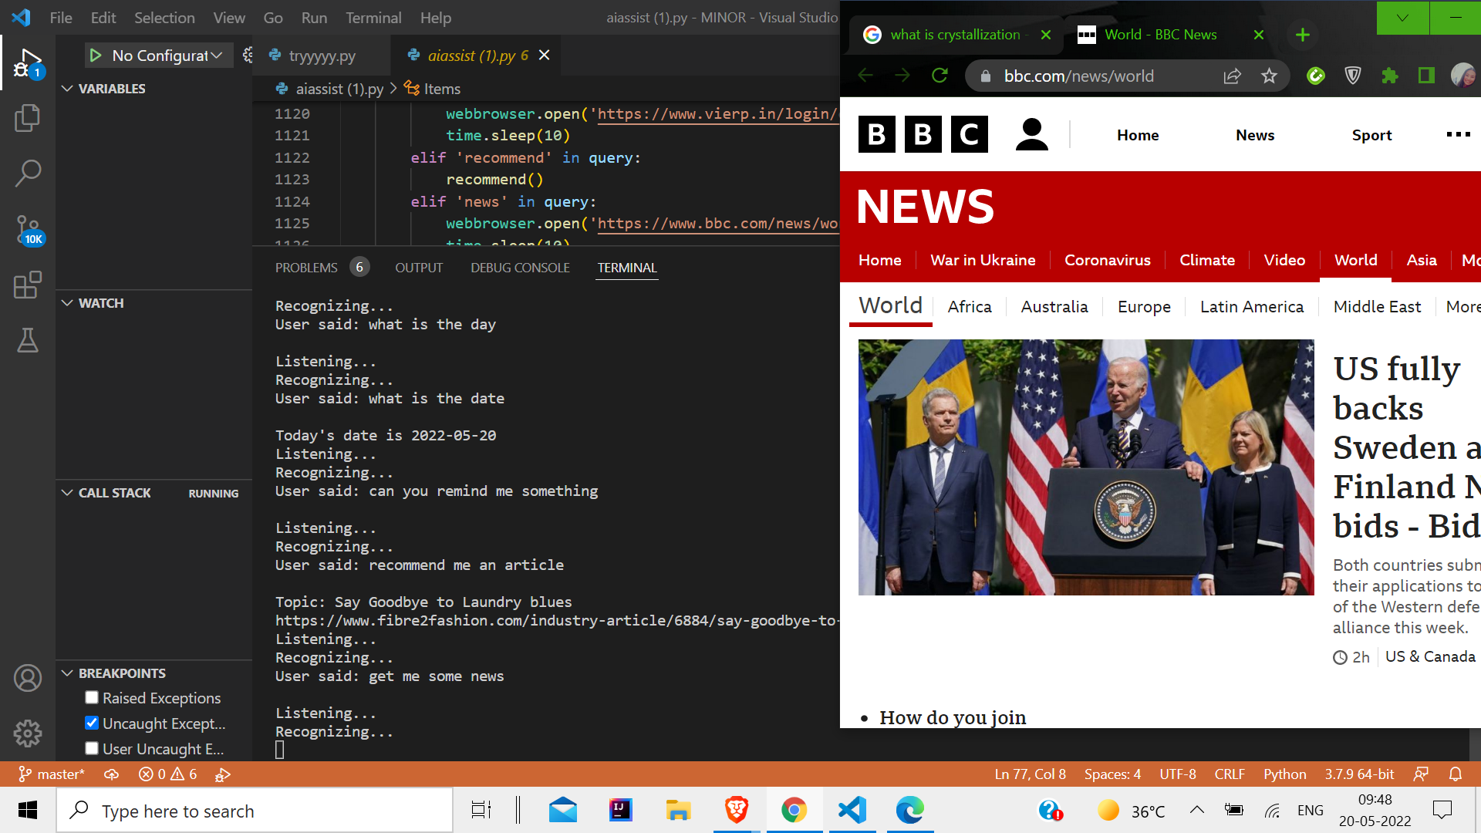

Slide 14
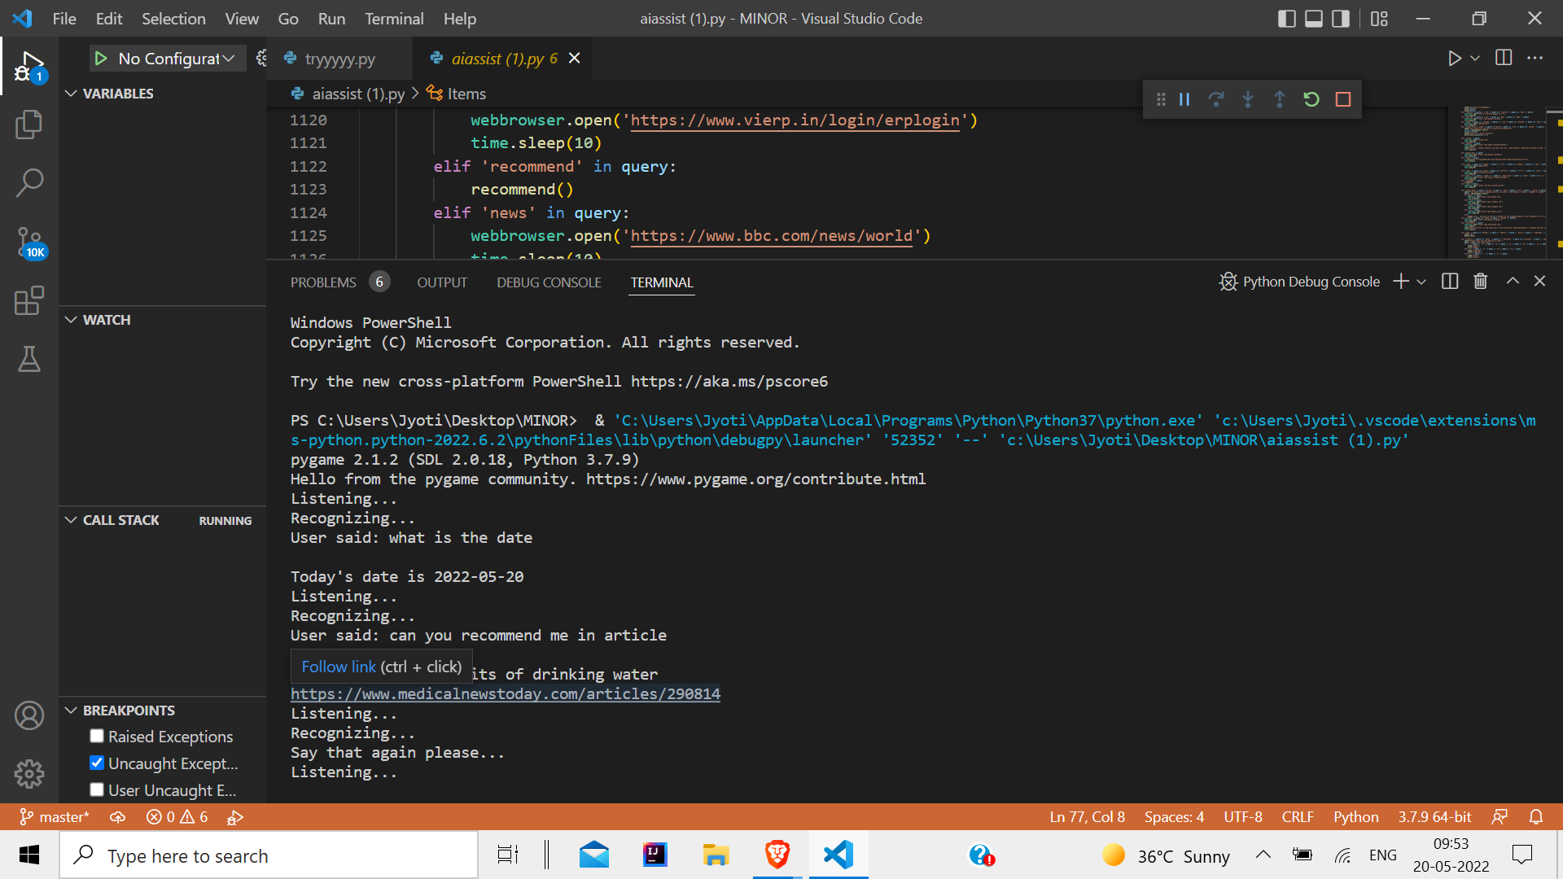
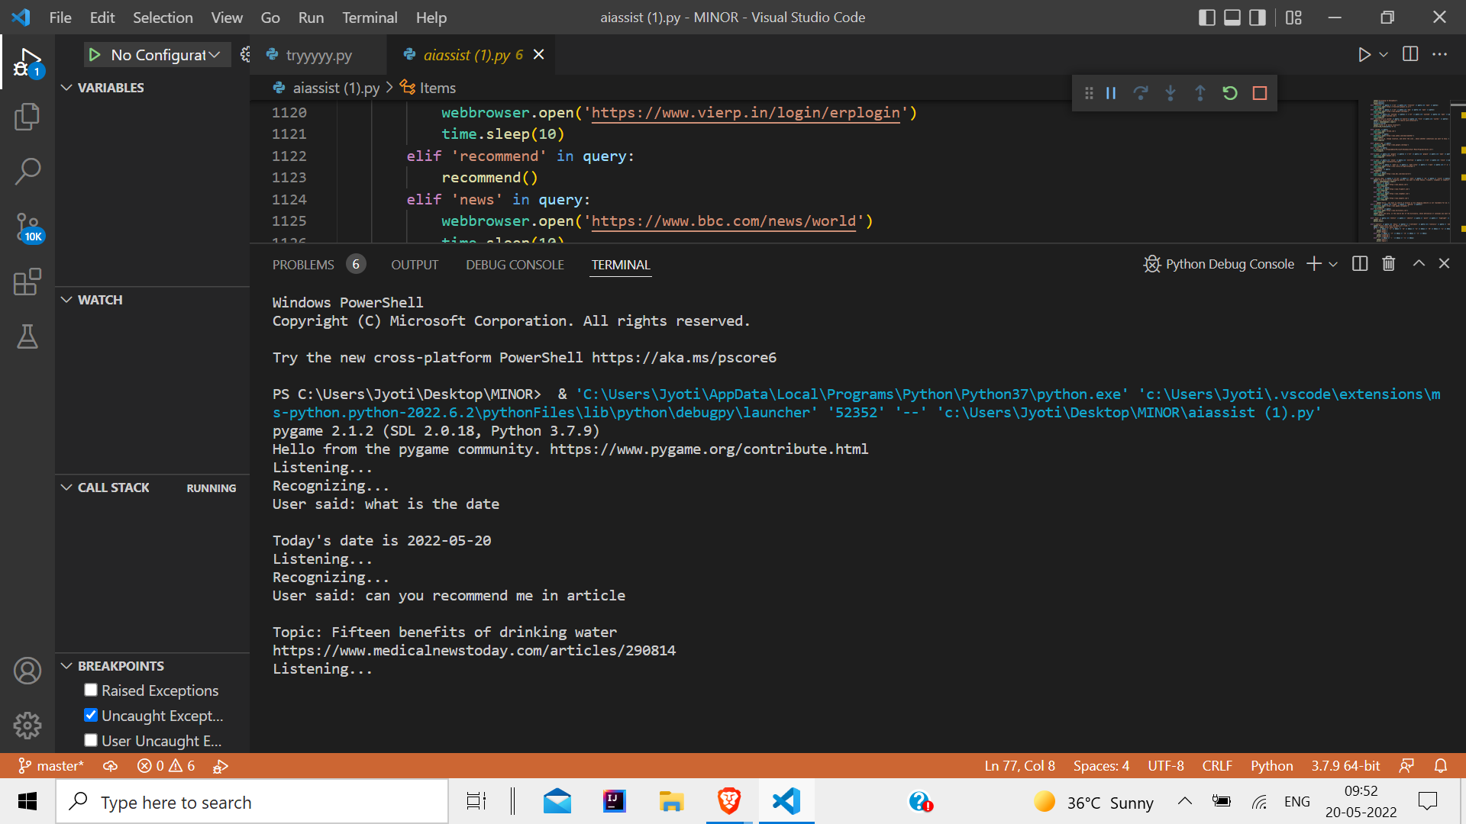

Slide 15
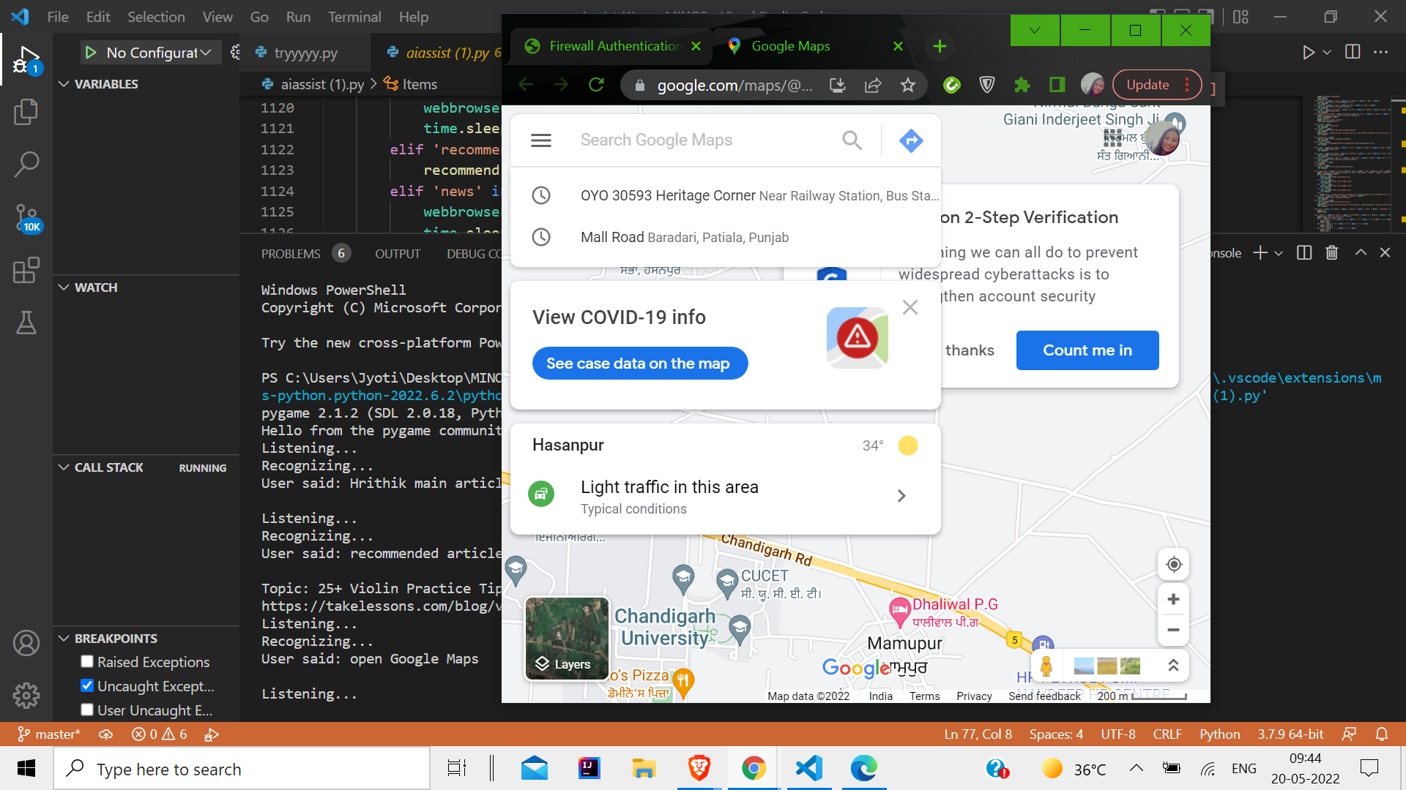

Slide 16
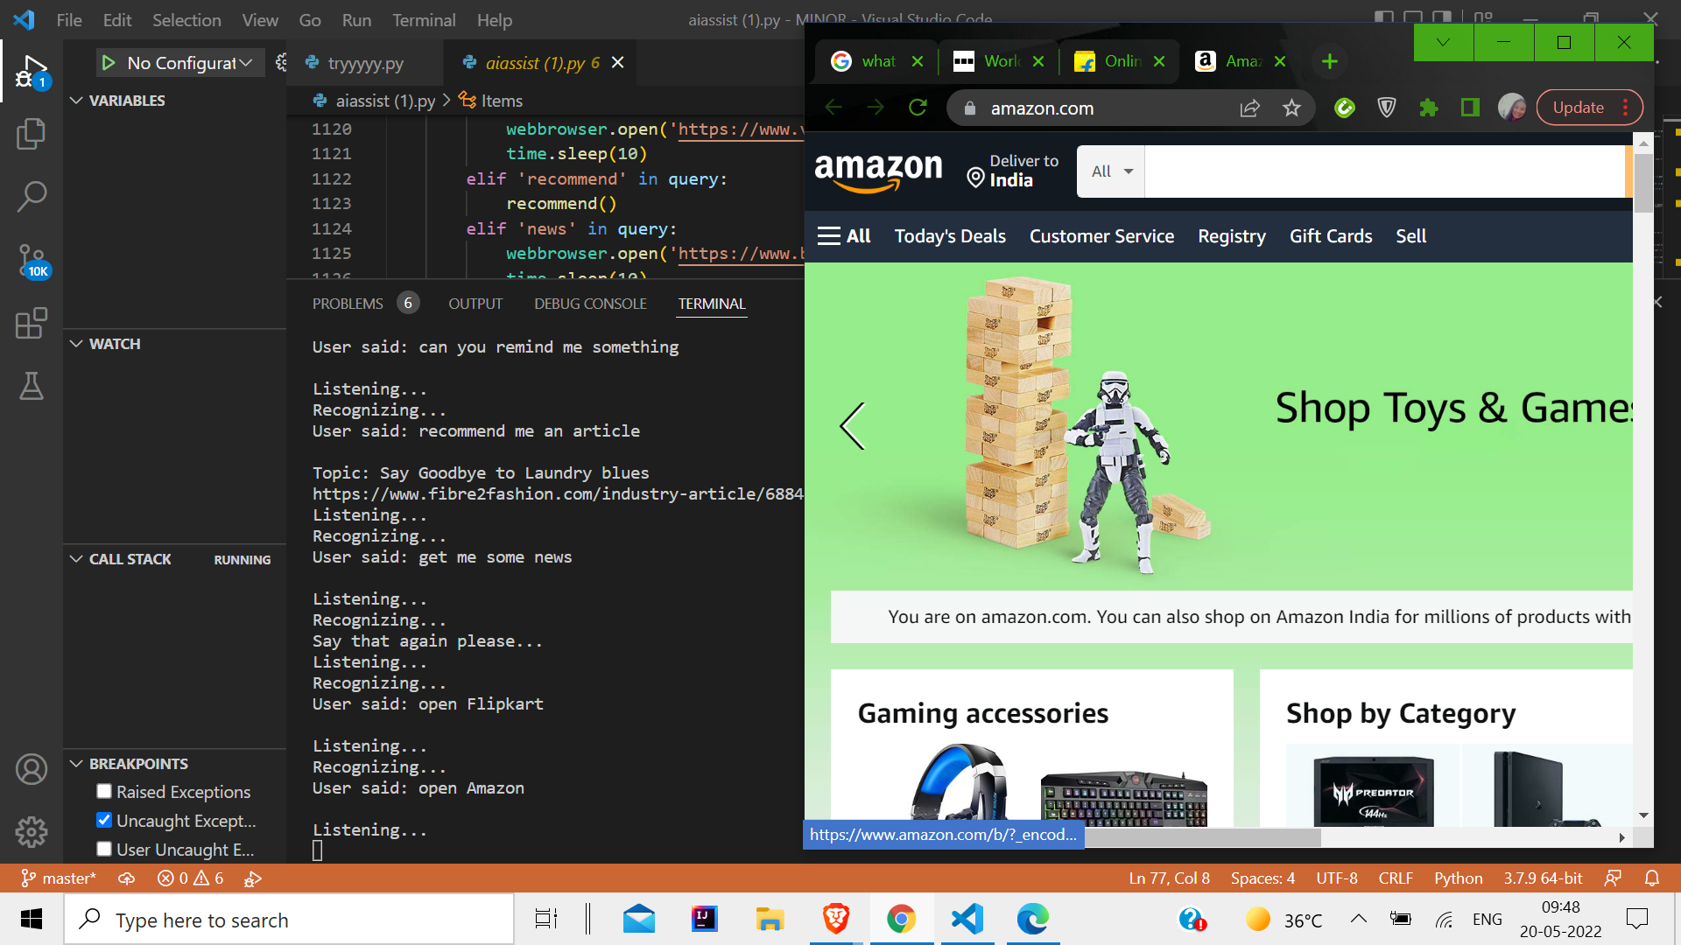
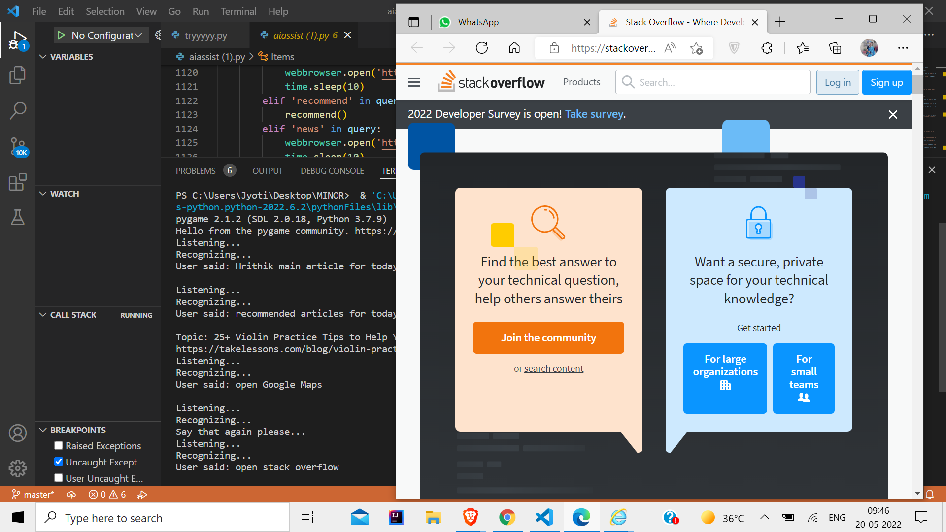

Slide 17
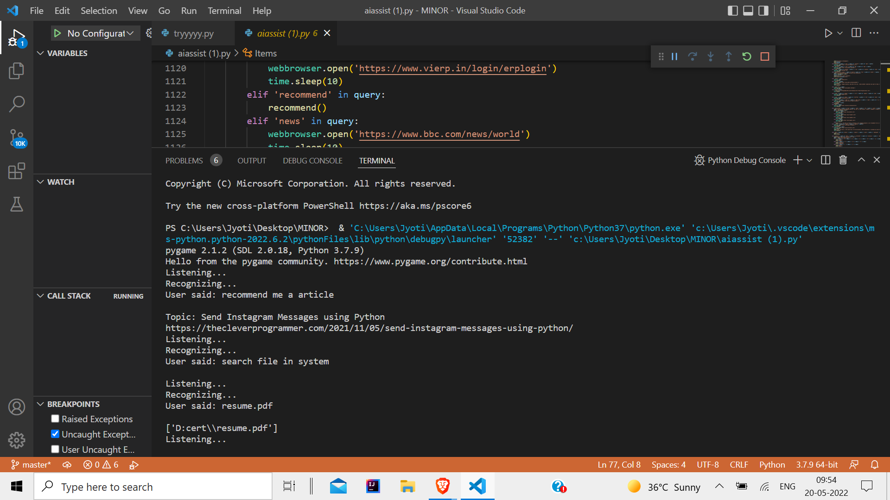

Slide 18
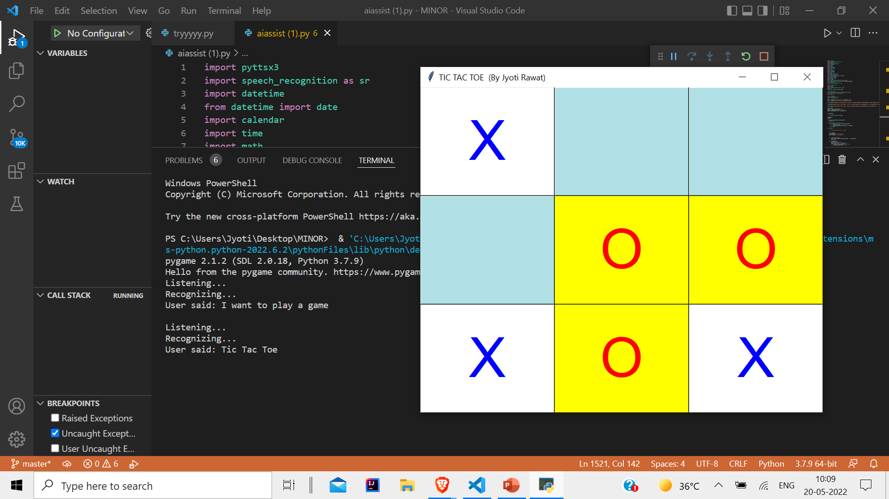

Slide 19
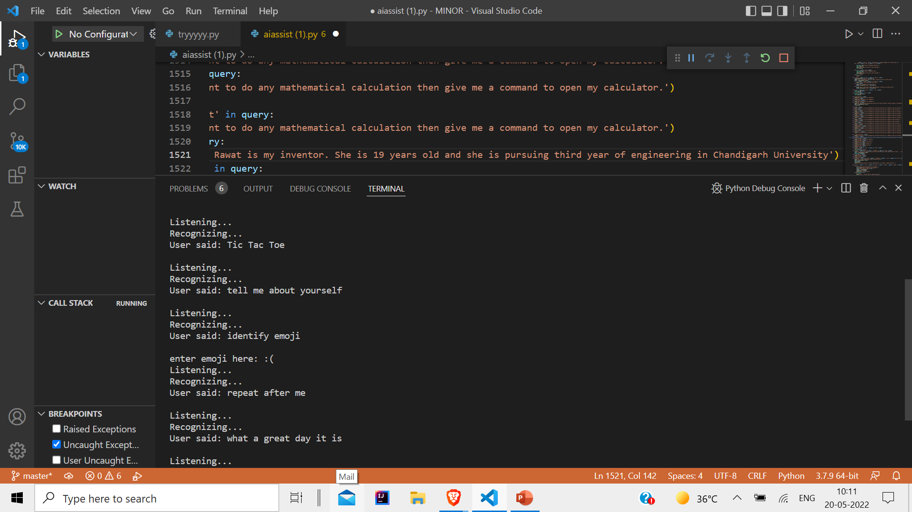

Slide 20
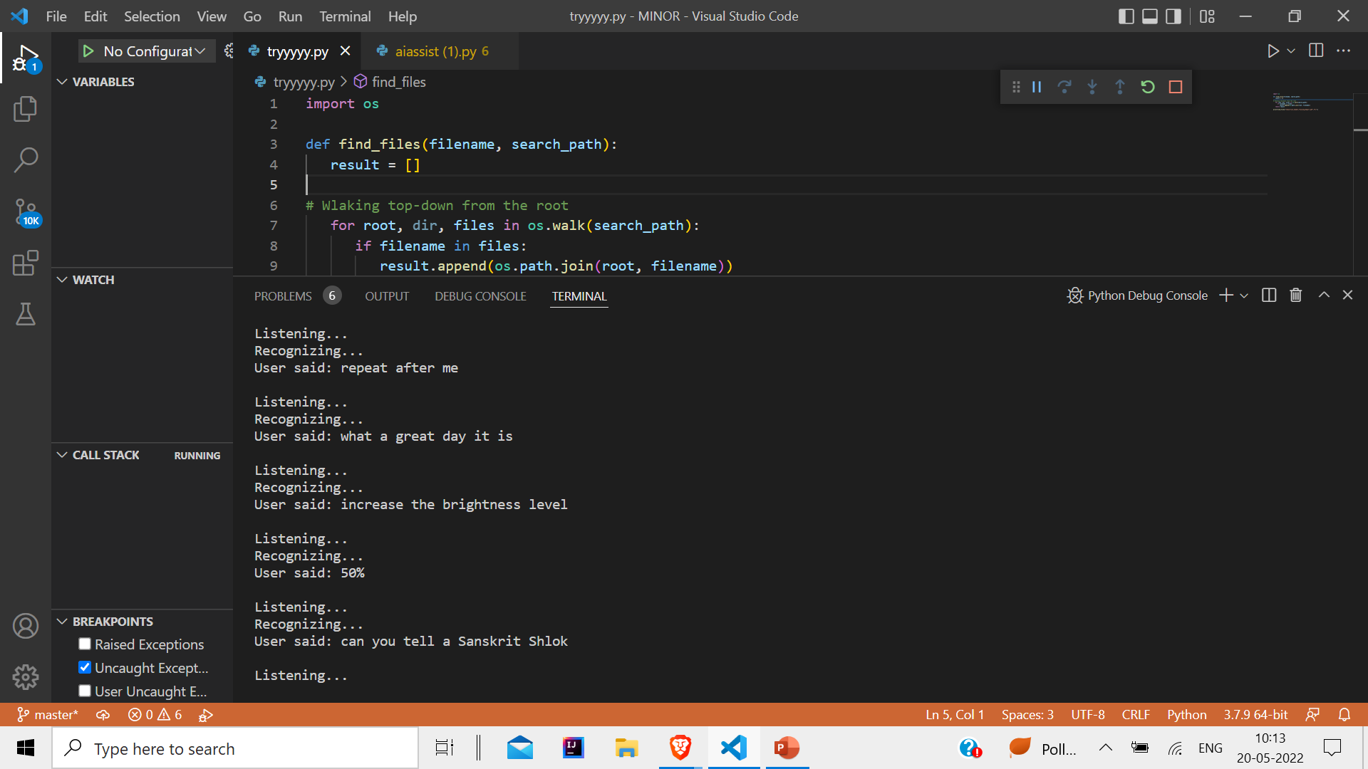

Slide 21
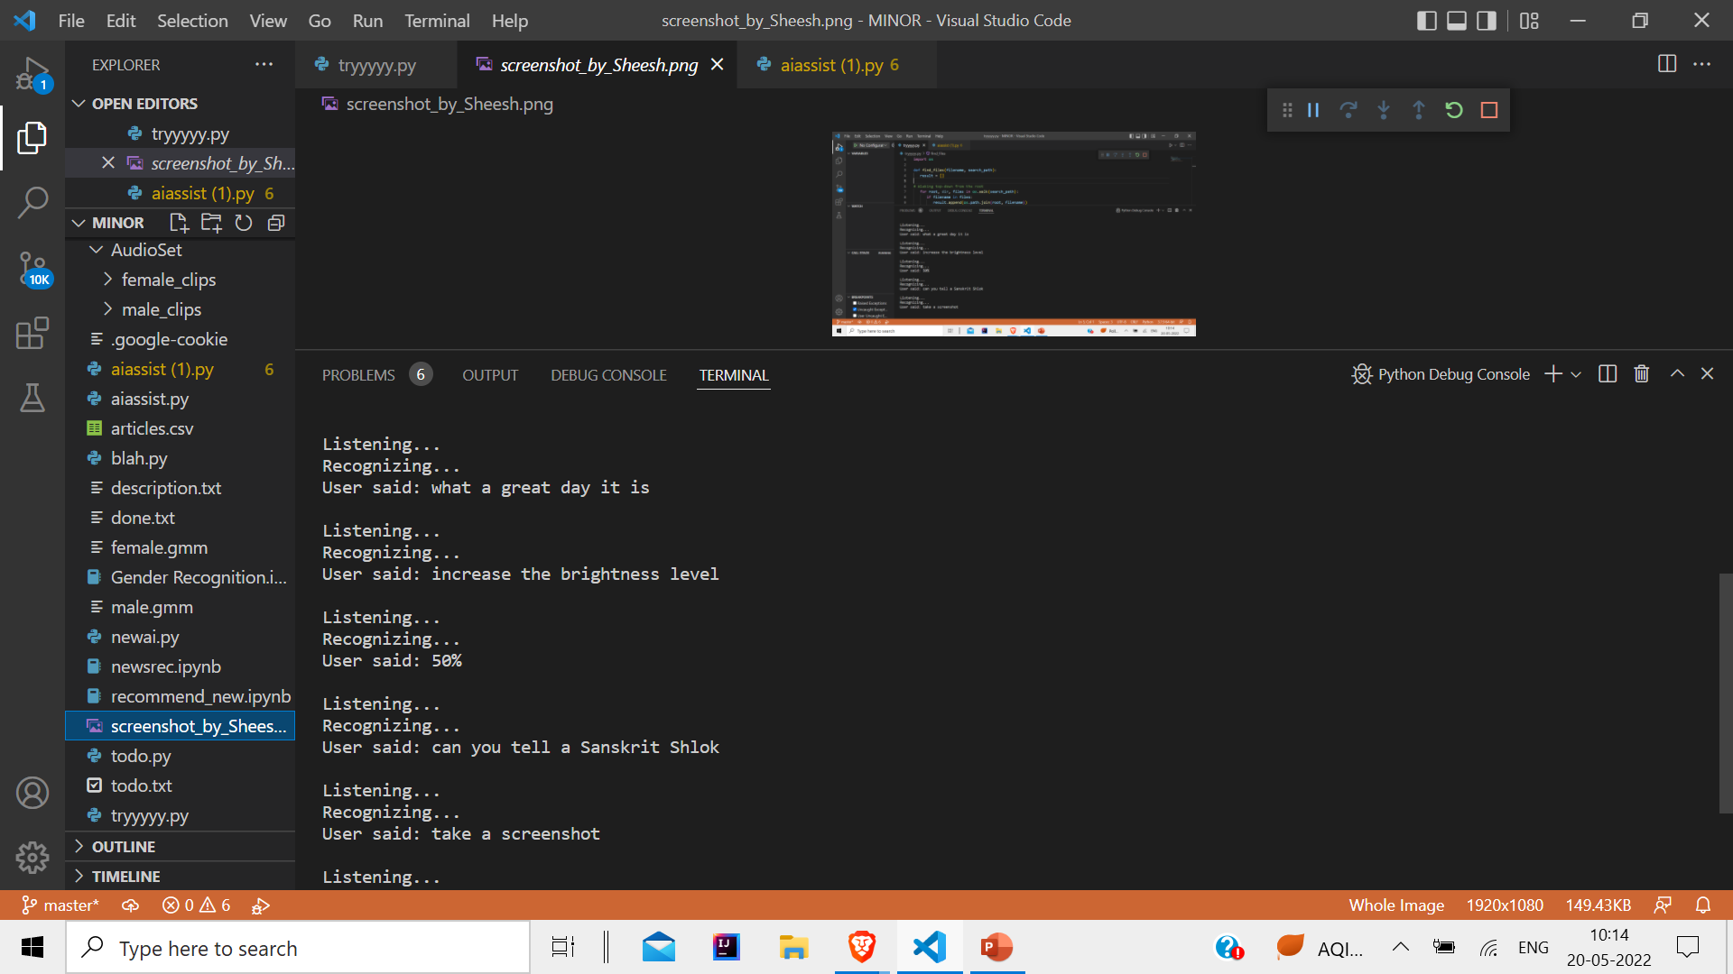

Slide 22
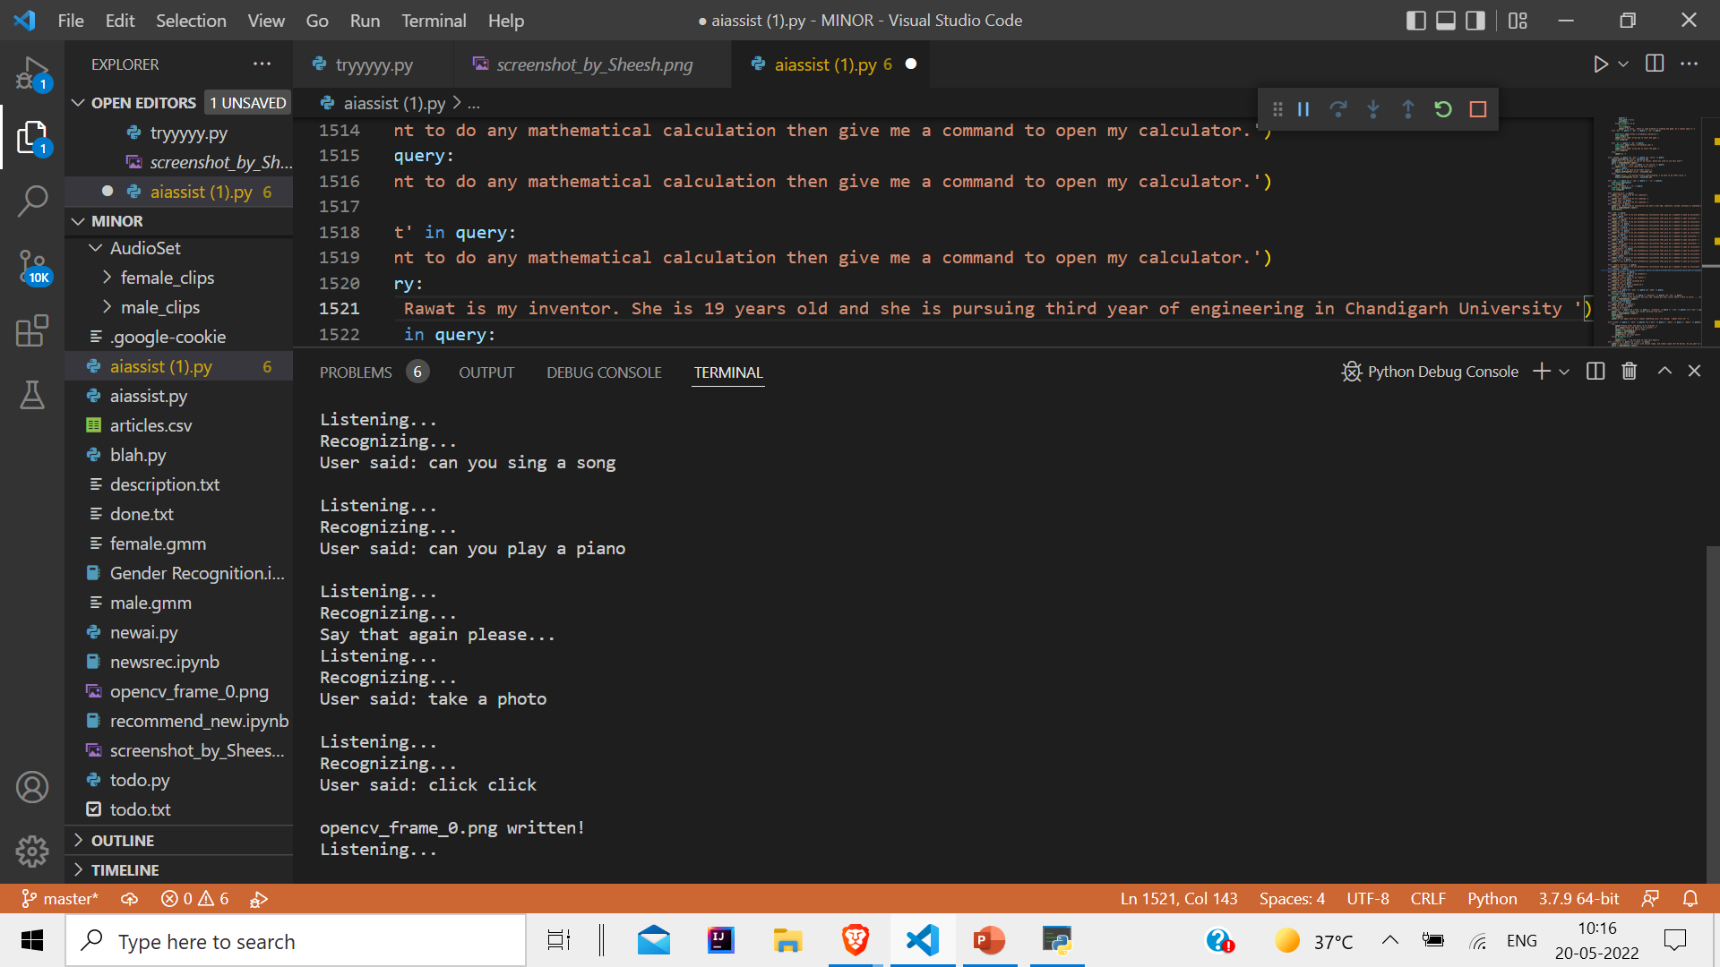

Slide 23
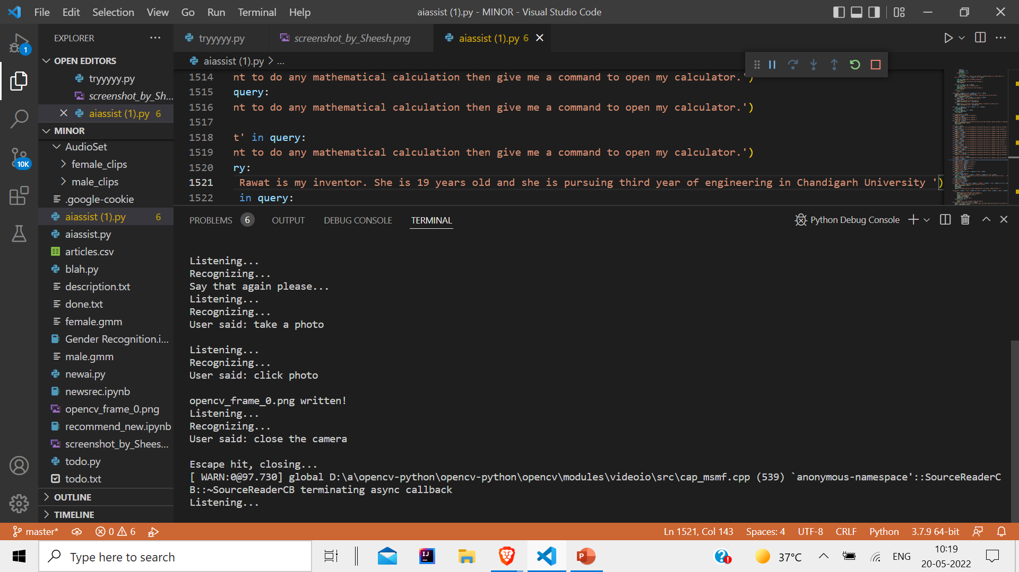

Slide 24
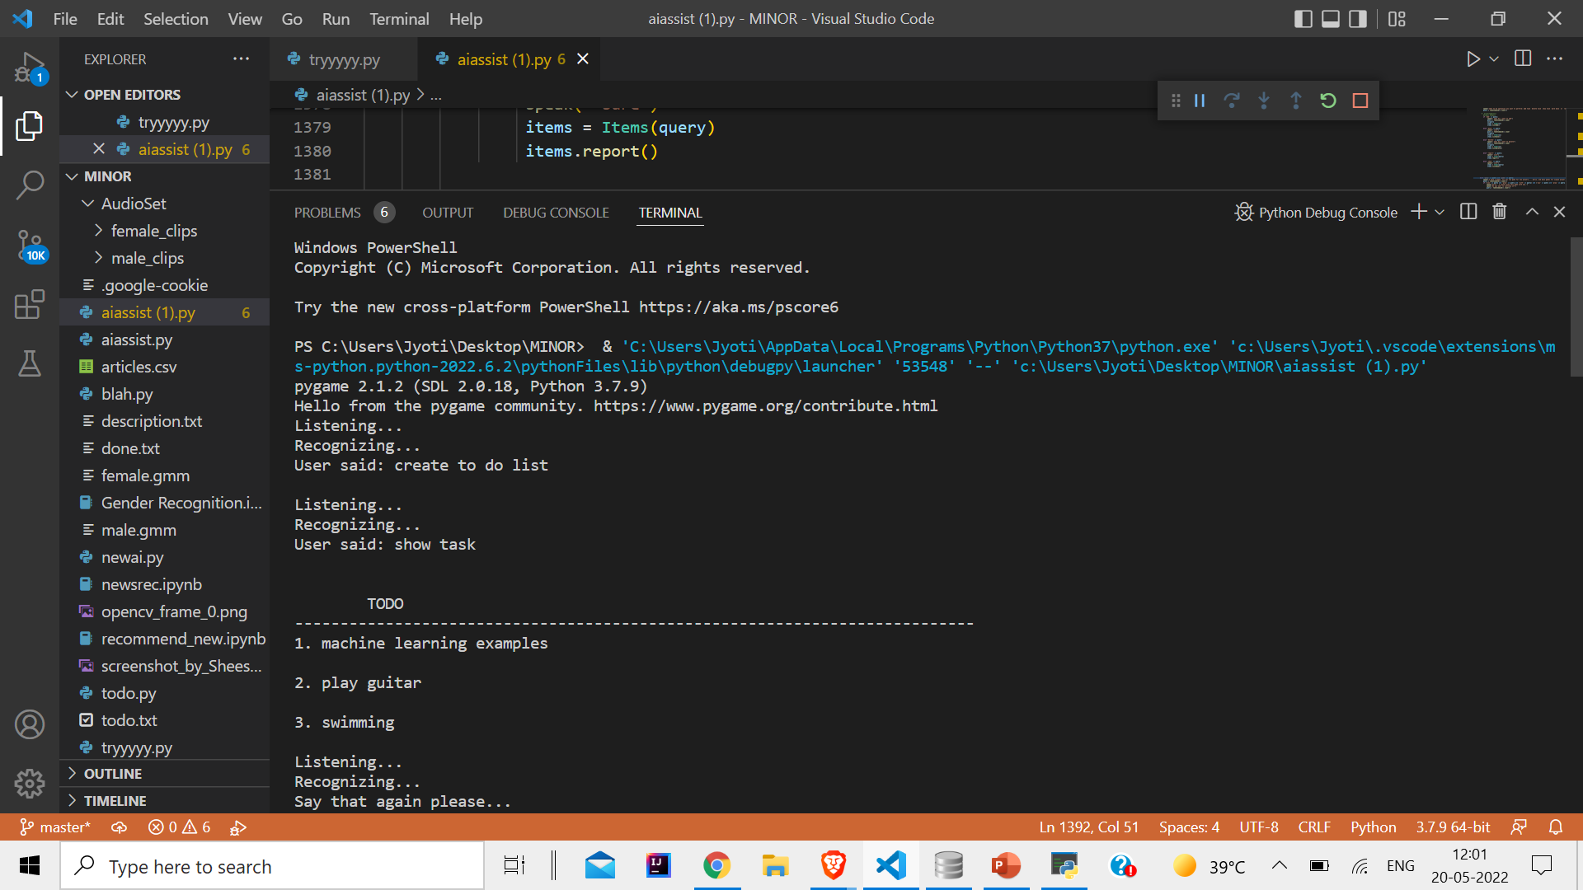

Slide 25
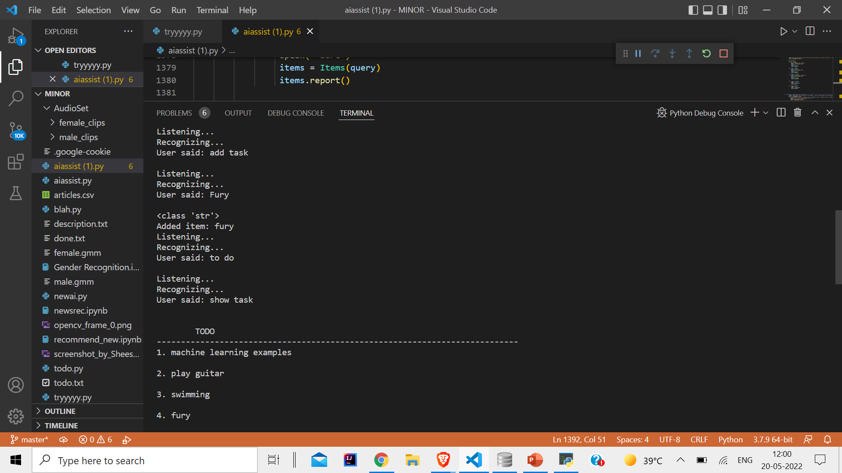
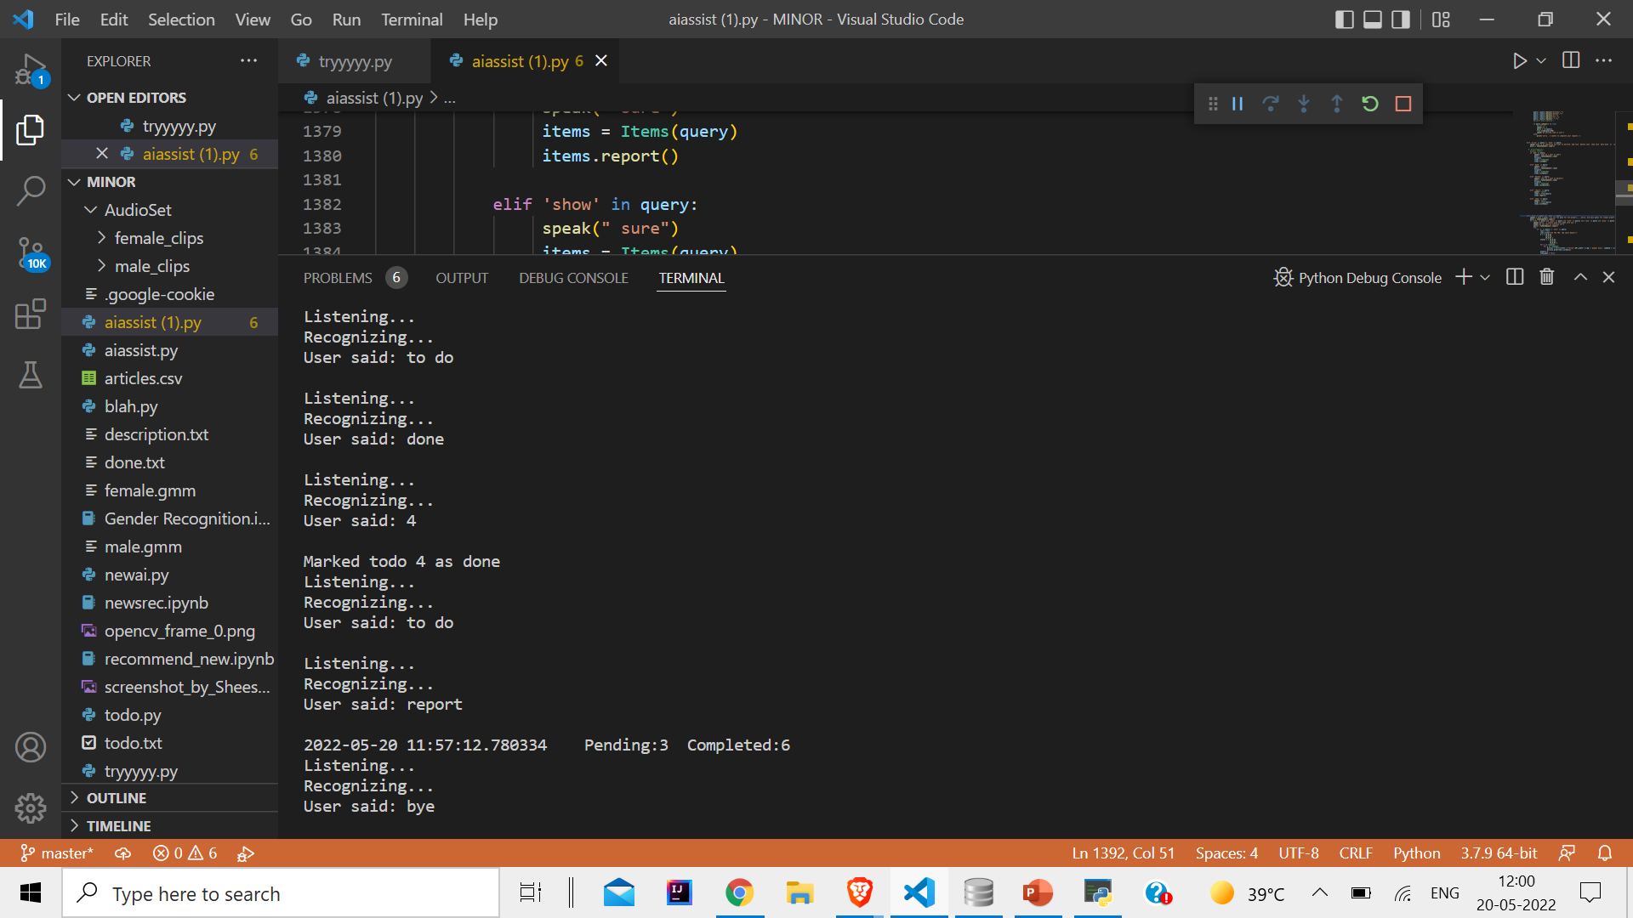

Slide 26
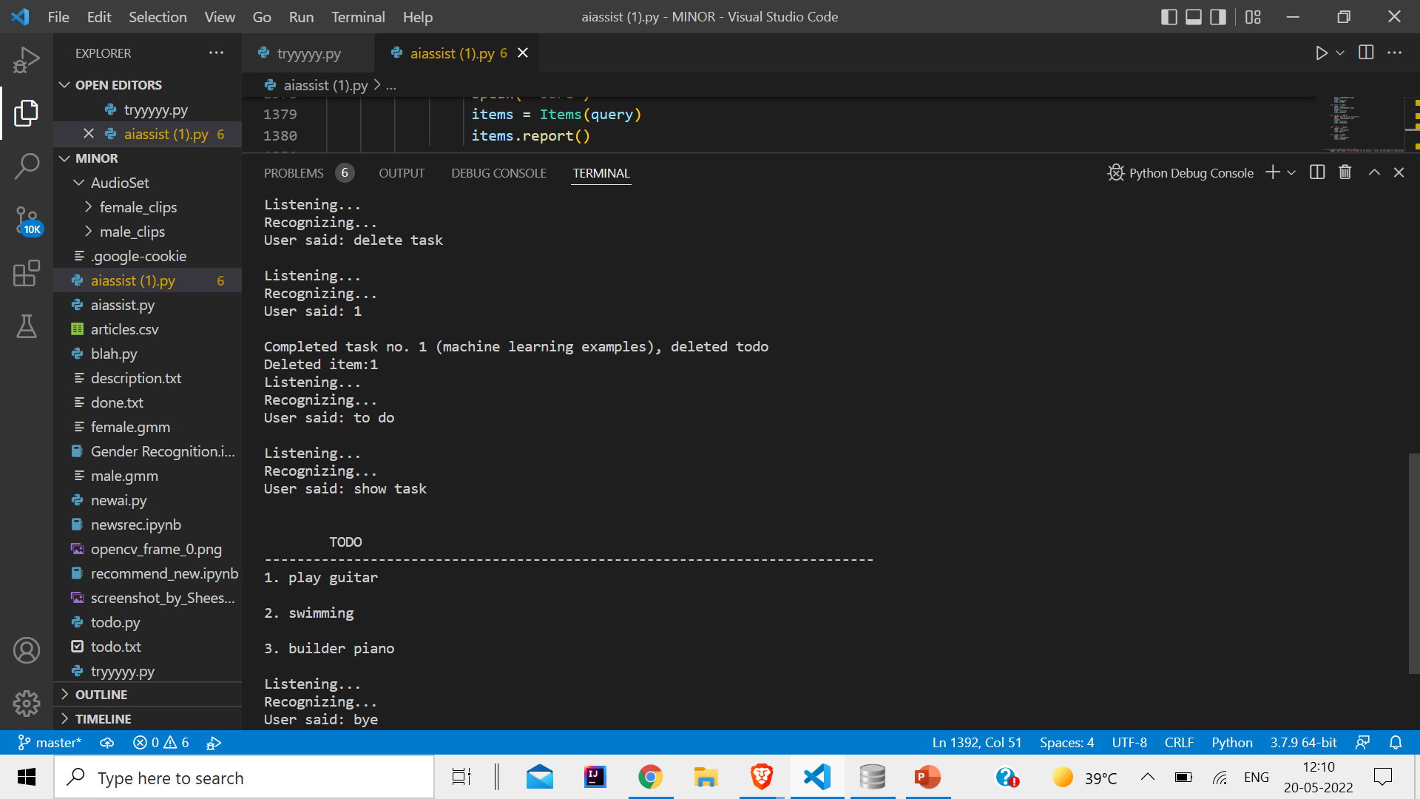

Slide 28
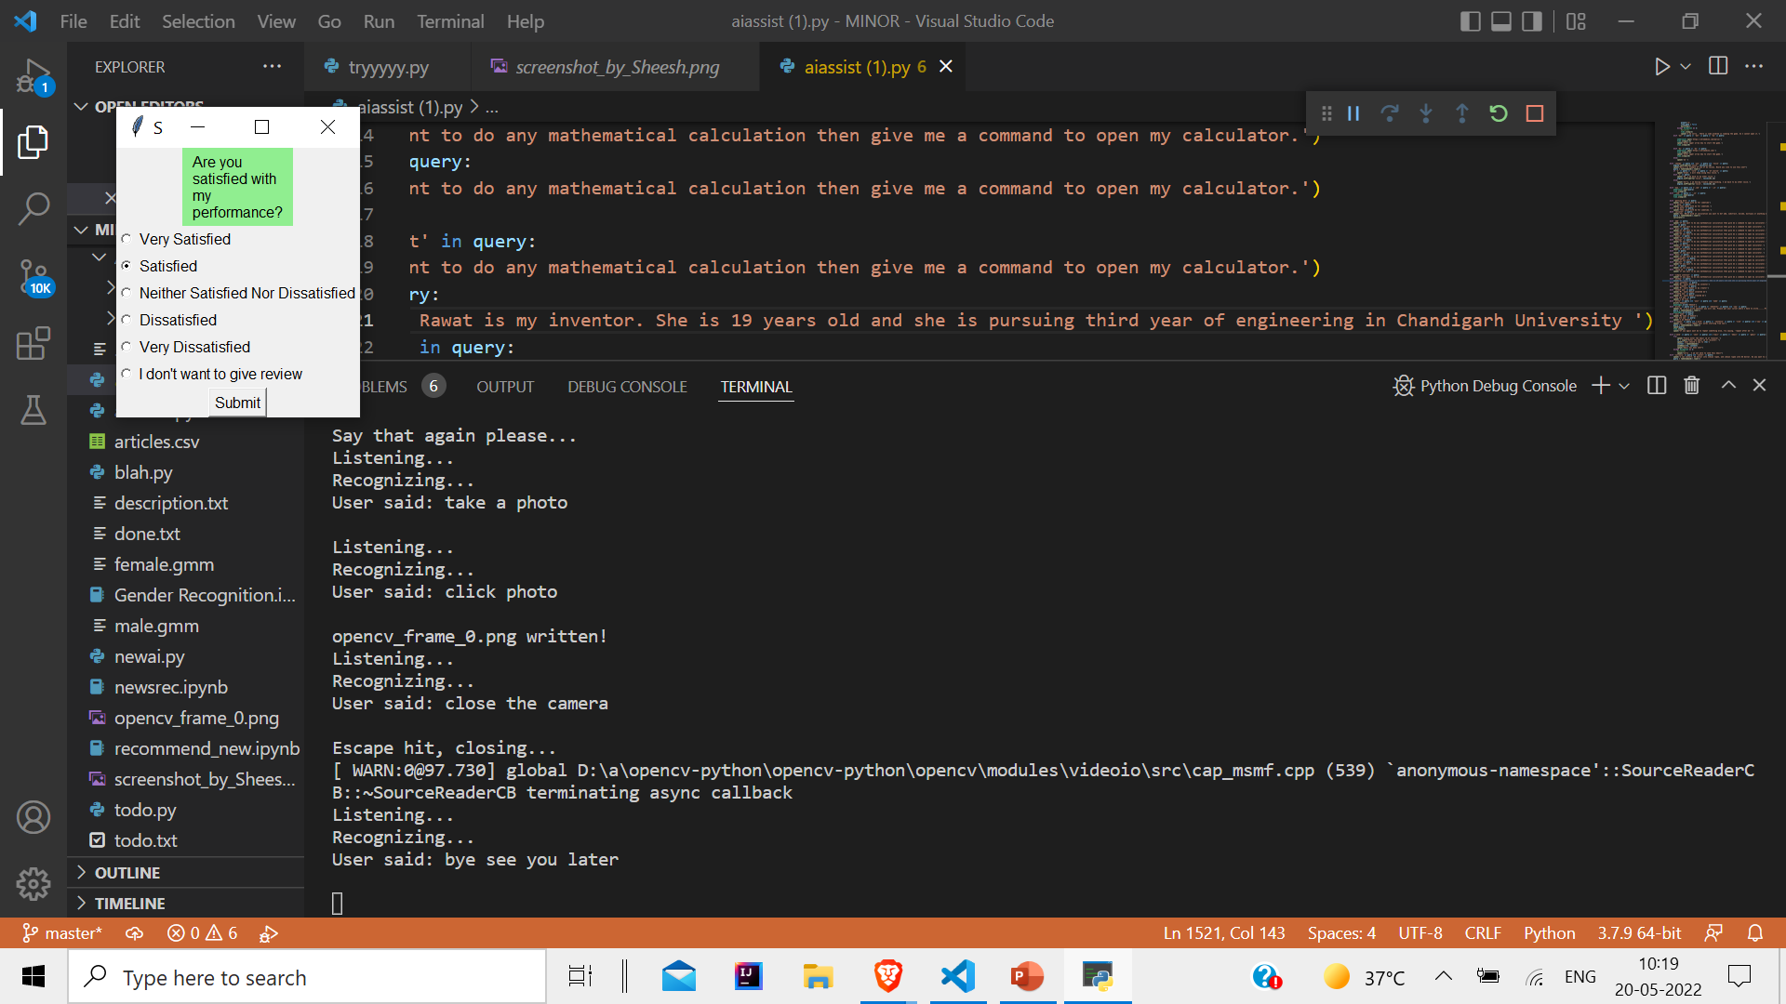

Slide 29
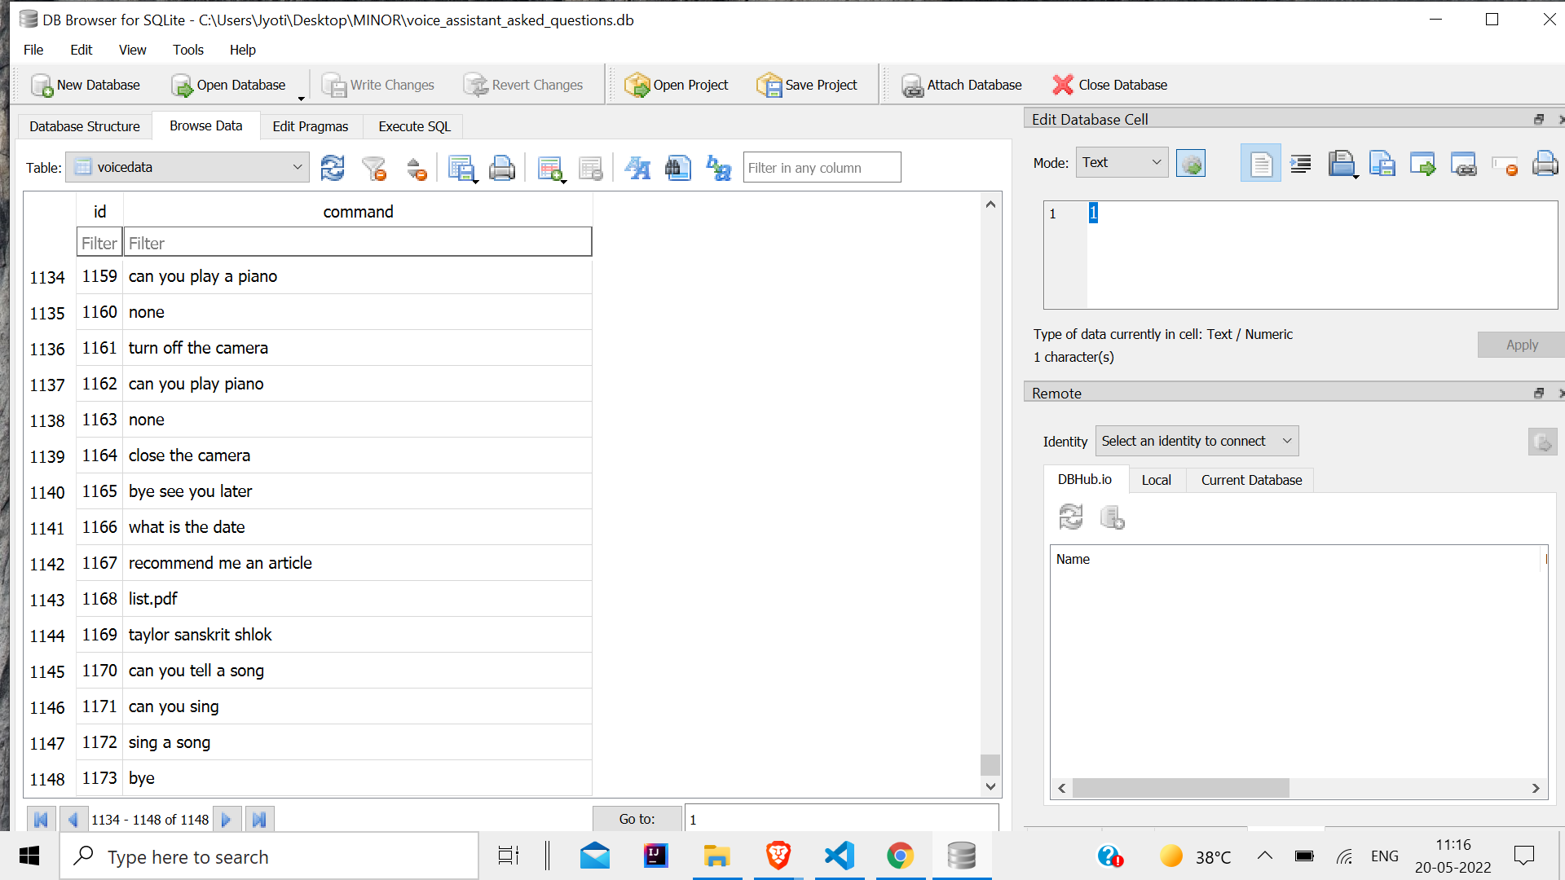
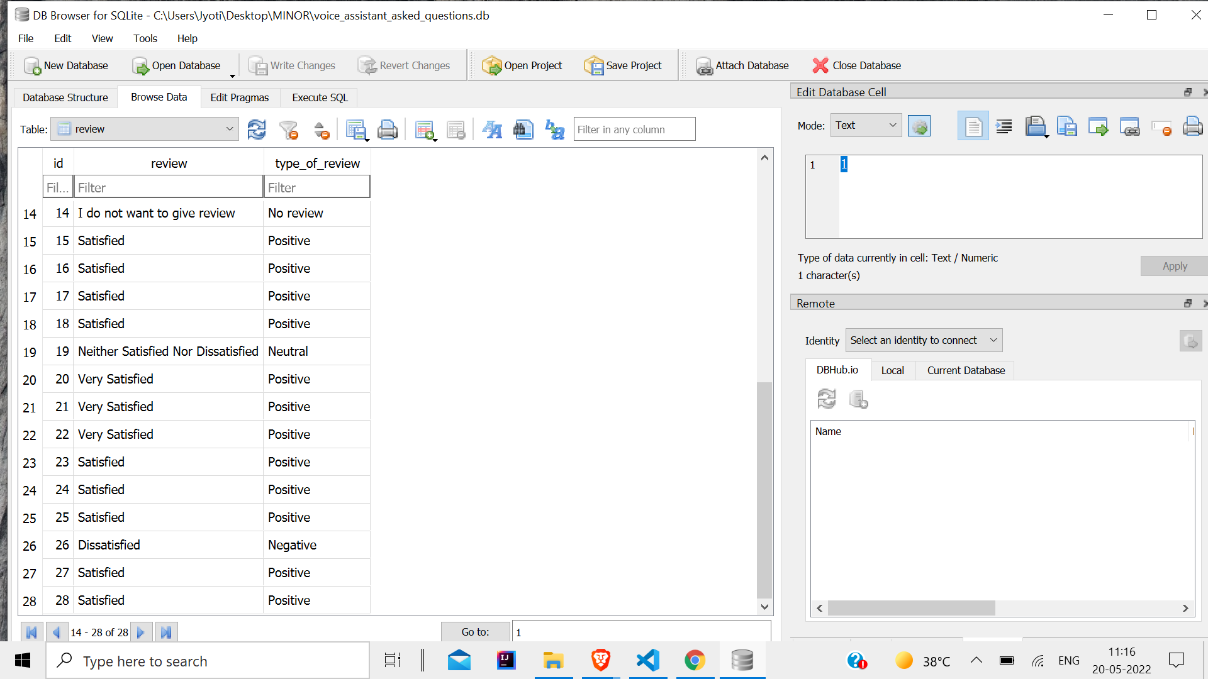

Slide 30
Conclusion
There can be no doubt that voice assistants are, and will continue to become, a great feat of human ingenuity and they are already creeping into our lives in some shape or form. With the eventual roll-out of 5G and the improvement in machine learning voice assistants may be setting themselves up to be a tool we cannot live without.
However, before we get to that stage, there are hurdles to cross which include heavy investment, improvement in the technology and confidence from consumers that this device that is in their lives does not pose a risk to their privacy.

Slide 31
Future Scope
Ways to decrease the background noise will also be focused
Accuracy of the voice recognition model will be improved so the it can also recognize clearly in background noise environment.
Can be trained for more automatic features possible.

Slide 32
References
[1] “ G. Bohouta, V. Z. Këpuska, "Comparing Speech Recognition Systems (Microsoft API Google API And CMU Sphinx)", Int. Journal of Engineering Research and Application 2017, 2017." (“Virtual Assistant with Applications of IOT”)
[2] Artificial intelligence (AI), sometimes called machine intelligence. https://en.wikipedia.org/wiki/Artificial_intelligence
[3] B. Marr, The Amazing Ways Google Uses Deep Learning AI.
[4] Cortana Intelligence, Google Assistant, Apple Siri.
[5] Hill, J., Ford, W.R. and Farreras, I.G., 2015. Real conversations with artificial intelligence: A comparison between human– human online conversations and human–chatbot conversations. (“(PDF) Real conversations with artificial ... - Academia.edu”) Computers in Human Behavior, 49, pp.245-250.
[6] K. Noda, H. Arie, Y. Suga, T. Ogata, Multimodal integration learning of robot behavior using deep neural networks, Elsevier: Robotics and Autonomous Systems, 2014.
[7] "CMUSphnix Basic concepts of speech - Speech Recognition process". http://cmusphinx.sourceforge.netlwiki/tutorialconcepts

Slide 33
[8] Huang, J., Zhou, M. and Yang, D., 2007, January. Extracting Chatbot Knowledge from Online Discussion Forums. In IJCAI(Vol. 7, pp. 423-428).
[9] Thakur, N., Hiwrale, A., Selote, S., Shinde, A. and Mahakalkar, N., Artificially Intelligent Chatbot.
[10] Mohasi, L. and Mashao, D., 2006. Text-to-Speech Technology in Human-Computer Interaction. In 5th Conference on Human Computer Interaction in Southern Africa, South Africa (CHISA 2006, ACM SIGHI) (pp. 79-84).
[11] Lindasalwa Muda, Mumtaj Begam and I. Elamvazuthi, Voice Recognition Algorithms using Mel Frequency Cepstral Coefficient (MFCC) and Dynamic Time Warping (DTW) Techniques, Journal Of Computing, Volume 2, Issue 3, March 2010.
[12] Parwinder Pal Singh and Pushpa Rani, An Approach to Extract Feature using MFCC, IOSR Journal of Engineering, Vol. 04, August. 2014.
[13] D.Shakina Deiv, Gaurav, Mahua Bhattacharya, Automatic Gender Identification for Hindi Speech Recognition, International Journal of Computer Applications (0975 – 8887) Volume 31– No.5, October 2011.
[14] M.A Anusuya. and S.K. Katti, Front End Analysis of Speech Recognition- A review, Int J Speech Technol, Springer, DOI 10.1007/s10772-010-9088-7

Slide 34
[15] M.Li, K. Han and S. Narayanan, automatic Speaker Age and Gender Recognition Using Acoustic and Prosodic Level Information Fusion, Computer Speech and Language, Jan 2013.
[16] Jamil Ahma, Mustansar, Fiaz, Soon-il Kwon, Maleerat Soanil, Bay Vo and Sung Wook Baik, Gender Identification using the MFCC for Telephone Applications- A Comparitive Study, International Journal of Computer Science and Electronics Engineering (IJCSEE) 2015.

